Slide 1

Social Security:
With You Through Life’s Journey…
Produced at U.S. taxpayer expense
Notes:
2021 Universal PowerPoint Master Copy – updated 10/6/2021
Notes to speaker:
You may want to add the name of the organization or event (seminar, conference, workshop, etc.) and the date of the event to this slide by clicking Insert, then clicking Text Box, and typing in the details.
DO NOT remove the taxpayer expense disclaimer from this slide, as it is now required by law.
Be sure to thank the person who invited you to speak, thank the organization for making SSA a part of today’s event, and make a few introductory comments (such as how long you have worked at SSA, your job title, and why you feel Social Security is relevant to this event/organization).
BEGINNING OF SPEAKER’S FORMAL SCRIPT:
For more than 80 years, Social Security has helped secure today and tomorrow by providing benefits and financial protection for millions of people throughout their life’s journey.
Social Security touches the lives of every American, both directly and indirectly. As you consider the information that you are about to receive, I encourage you to think about all the ways Social Security has been linked to your life – and the lives of your loved ones.

Slide 2

We’re With You If
The Unexpected Happens
Notes:
Disability could happen at any moment in our lives. Social Security disability benefits provide financial support to people when they need it most.
For people who can no longer work due to a disability, our disability program is there to replace some of their lost income.
Disability benefits provide modest coverage for severely disabled workers and their dependents, including wounded warriors.

Slide 3
Social Security Disability Insurance (SSDI)
What is it?
SSDI provides a monthly benefit to people who are no longer able to work because of a significant disabling condition(s). SSA does not pay partial or temporary disability benefits.
Who is it for?
People who cannot perform substantial work activity may qualify if they:
have medical condition(s) expected to last at least 12 months or result in death
are younger than full retirement age (FRA) and earn less than the substantial gainful activity (SGA) limit
have recent work and a certain number of work credits based on age
ssa.gov/disability
Notes:
Social Security’s disability definition requires you to have a medical condition that prevents you from doing substantial work for at least 12 months or your condition is terminal. This work determination is based on your age, education, and work experience.
Our definition makes the clear distinction between Social Security’s disability requirements compared to other disability programs, such as Veterans and Workman’s Compensation.
In addition to meeting the definition of disability, you must also have worked long enough – and recent enough – to qualify.
The number of work credits you need to qualify for disability benefits depends on your age when you become disabled. Generally, you need 40 credits, 20 of which were earned in the last 10 years ending with the year you become disabled. For younger workers, less work/fewer credits are required.
You can apply for disability benefits in person, by telephone, by mail, or online.
The application is then sent to a State Disability Determination Services for evaluation of disability.
After becoming eligible for a disability benefit, the law requires us to conduct a medical review to ensure that the beneficiary still qualifies for the program. This generally occurs every 3 to 7 years, depending on the severity of the disability.
Slide updated 9/2/2020 (JP)

Slide 4
Supplemental Security Income (SSI)
What is it?
SSI is a federal program that provides monthly payments to people who have limited income and resources.
Who is it for?
People who are 65 or older, as well as for those of any age, including children, who are blind or who have disabilities and have limited income and resources.
ssa.gov/benefits/ssi
Notes:
If you are disabled but do not have enough credits to qualify for SSDI and you have limited income and resources, you may be eligible for Supplemental Security Income.
SSI is a federal income supplement program funded by general tax revenues, not Social Security taxes.
Social Security administers the SSI program, which pays monthly benefits to adults with limited income and resources who are disabled, blind, or age 65 or older. Blind or disabled children may also get SSI.
People who have worked long enough, recently enough, may be able to receive Social Security benefits – such as disability or retirement – and SSI benefits at the same time, if the amount of Social Security benefits in combination with the person’s other income falls below the SSI income limits.
Supplemental Security Income publication # 05-11000 -- https://www.ssa.gov/pubs/EN-05-11000.pdf
Slide updated 1/13/2021 (JP)
Slide updated 9/2/2020 (JP)

Slide 5
SSDI vs. SSI
Social Security Disability Insurance | Supplemental Security Income
Payments come from Social Security trust funds and are based on a person’s earnings. | Payments come from the general treasury fund, NOT the Social Security trust funds. SSI payments are not based on a person’s earnings.
Insurance that workers earn by paying Social Security taxes on their wages. | Needs-based public assistance program that does not require a person to have a work history.
Pays benefits to disabled individuals who are unable to work, regardless of their income and resources. | Pays disabled individuals who are unable to work AND have limited income and resources; pays aged individuals 65 and older with limited income and resources.
Pays benefits for workers and for adults disabled since childhood. Must meet insured status requirements. | Benefits for children and adults in financial need. Must have limited income and limited resources.
Notes:
When you file an application for disability benefits with Social Security, we always check on your eligibility for both of our programs. The same medical requirements apply to both programs, but the non-medical requirements differ.
Staff at your local Social Security field office review your non-medical eligibility. If you meet the non-medical requirements for SSDI, SSI, or both programs, we send your claim – or claims – to a medical examiner who works for the state of ___(your state).
Specifically, the medical examiners work for a state agency called the Disability Determination Service, or DDS. Once the medical examiner makes a medical decision on your application, you receive notification by mail, and your local Social Security field office receives notification electronically. If your claim is approved, you start receiving monthly disability benefits. If denied, you have 60 days to file an appeal.
For SSDI, you must have recent work history in order to receive benefits. Adults must have worked and earned Social Security credits in 5 out of the 10 years prior to the onset of the disability.
For younger workers, however, less work is required. For example:
Before age 24:
1 ½ years of work in a three-year period before becoming disabled
Age 24-31:
work during half the time between age 21 and the time the disability began
Age 31 or older:
work during five out of the 10 years before the disability began
However, since you do not need to work and gain insured status for SSI, babies and older people who have never worked can receive SSI benefits. They just need to be blind, disabled, or age 65 or older and have limited income and resources.
Social Security has a specific set of rules that apply to disability beneficiaries. If you receive Social Security disability benefits or Supplemental Security Income payments, you must report all earnings to Social Security.
Content review by OISP-OSSIPIP 12/8/2020

Slide 6
Requirements for Getting SSI
To be eligible for SSI, you must:
have limited income and few resources;
be age 65 or older;
be totally or partially blind; or
have a medical condition that keeps you from working and is expected to last at least one year or result in death.
Note: There are different rules for children.
Notes:
https://www.ssa.gov/ssi/text-eligibility-ussi.htm
Information for children starts on slide 26.

Slide 7
Requirements for Getting SSI
Your income – money you receive such as wages, Social Security benefits, and pensions. Income also includes such things as food and shelter.
Your resources – things you own such as real estate, bank accounts, cash, stocks, and bonds.
Where you live – must live in the U.S., or Northern Mariana Islands. If you’re not a U.S. citizen, but you are lawfully residing in the United States, you still may be able to get SSI.

Slide 8
Income
Earned | Unearned
Wages | SSA benefits
Net earnings from self-employment | Veterans benefits
Payment for services in sheltered workshop | Unemployment benefits
 | Interests
 | Pensions
 | Cash from family/friends

Slide 9
Resources
Included Resources | Excluded Resources
Bank Accounts (CDs, IRAs) | Home in which you live
Stocks, Bonds, 401Ks (Liquid Assets) | First car
Second Car | Burial plots for self & family
Life Insurance | Some resources set aside for burial
Property other than where you live
Individual Limit: $2,000 / Couples Limit: $3,000
Notes:
https://www.ssa.gov/ssi/text-resources-ussi.htm

Slide 10
Living Arrangements
Living arrangements are another factor to determine how much SSI a person can get. Benefits may vary depending on where you live:
In someone else’s household
In an institution – generally $30/month maximum
In a group care or board and care facility
Notes:
https://www.ssa.gov/ssi/text-living-ussi.htm

Slide 11
SSI Determination for Children Turning 18
We make a new disability determination using the adult rules.
We no longer count the income and resources of parent(s) for eligibility.
If the child continues to live with parent(s) but does not pay for food or shelter, a lower SSI payment may apply.
An SSI application can be made as early as the day of the 18th birthday.

Slide 12
Definition of Disability - Adult
The Social Security Act defines disability as:
a person who cannot work due to a severe medical condition that has lasted, or is expected to last, at least one year or result in death; or
the person's medical condition must prevent him or her from doing substantial gainful employment – work that he or she did in the past, and it must prevent the person from adjusting to other work.

Slide 13
SSI and Age 18 Foster Children
A disabled youth transitioning out of foster care may file an SSI application if he or she:
lives in a foster care situation;
alleges blindness or disability;
appears likely to meet all of the non-medical eligibility requirements when foster care payments terminate;
expects foster care payments to cease within 180 days of the application filing date; or
is within 180 days of losing foster care eligibility because of age.

Slide 14
SSI & Homeless
Social Security defines “homeless” as:
A transient – an individual with no permanent living arrangement, i.e., no fixed place of residence. A transient is neither a member of a household nor a resident of an institution.
If you are homeless, you can receive your SSI benefits by:
having them deposited into your personal bank account;
having your benefits mailed to a third party;
having a relative or other third party be assigned as your representative payee; or
having your benefits directed to a Direct Express bank card.

Slide 15
When should I apply for disability benefits?
Apply as soon as you become disabled.
Processing an application for disability benefits can take three to five months.
We may be able to process your application faster if you help us by getting any other information we need.
Notes:
Processing an application for disability benefits can take three to five months.
The information we need includes:
Your Social Security number;
Your birth or baptismal certificate;
Names, addresses, and phone numbers of the doctors, caseworkers, hospitals, and clinics that took care of you, and dates of your visits;
Names and dosage of all the medicine you take;
Medical records from your doctors, therapists, hospitals, clinics, and caseworkers that you already have in your possession;
Laboratory and test results;
A summary of where you worked and the kind of work you did; and
A copy of your most recent W-2 Form (Wage and Tax Statement) or, if you’re self-employed, your federal tax returns for the past year.
In addition to the basic application for disability benefits, you’ll also need to fill out other forms. One form collects information about your medical condition and how it affects your ability to work. Other forms give doctors, hospitals, and other health care professionals who have treated you, permission to send us information about your medical condition.
Don’t delay applying for benefits if you can’t get all of this information together quickly. We’ll help you get it.

Slide 16
How to Apply for SSI (Adult)
You can begin the process and complete a large part of your application online!
You may be eligible to complete your application online if you:
    are between the ages of 18 and 65;
    have never been married;
    are a U.S. citizen;
    haven’t applied for or received SSI benefits in the past; and
    are applying for Social Security Disability Insurance at the same time as your SSI claim.
Notes:
Other Ways to Apply for SSI
By phone 1-800-772-1213
At our office

Slide 17
SSI: What Happens Next?
Your application will be forwarded to the state Disability Determination Services (DDS) agency.
The DDS will contact medical providers to obtain medical records.
The DDS may ask for additional information about how your condition(s) affect daily activities.
Notes:
You may have another appointment to update your living arrangement, income, and resource information.

Slide 18
How is a Disability Determination Made?
Five-step process:
Are you working?
Is your medical condition “severe” ?
Does your impairment(s) meet or medically equal a listing?
Can you do the work you did before?
Can you do any other type of work?
Notes:
https://www.ssa.gov/disability/professionals/bluebook
We use a five-step process to decide if you’re disabled.
1. Are you working?
If you’re working and your earnings average more than a certain amount each month, we generally won’t consider you to be disabled. The amount changes each year. For the current figure, see the annual Update (Publication No. 05-10003).
If you’re not working, or your monthly earnings average to the current amount or less, the state agency then looks at your medical condition.
2. Is your medical condition “severe”?
For you to be considered to have a disability by Social Security’s definition, your medical condition must significantly limit your ability to do basic work activities — such as lifting, standing, walking, sitting, and remembering — for at least 12 months. If your medical condition isn’t severe we won’t consider you to be disabled. If your condition is severe, we proceed to step three.
3. Does your impairment(s) meet or medically equal a listing?
Our list of impairments (https://www.ssa.gov/disability/professionals/bluebook/listing-impairments.htm) describes medical conditions that we consider severe enough to prevent a person from completing substantial gainful activity, regardless of age, education, or work experience. If your medical condition (or combination of medical conditions) isn’t on this list, the state agency looks to see if your condition is as severe as a condition on the list. If the severity of your medical condition meets or equals the severity of a listed impairment, the state agency will decide that you have a qualifying disability. If the severity of your condition doesn’t meet or equal the severity level of a listed impairment, the state agency goes on to step four.
4. Can you do the work you did before?
At this step, we decide if your medical impairment(s) prevents you from performing any of your past work. If it doesn’t, we’ll decide you don’t have a qualifying disability. If it does, we’ll proceed to step five.
5. Can you do any other type of work?
If you can’t do the work you did in the past, we look to see if there’s other work you can do despite your impairment(s). We consider your age, education, past work experience, and any skills you may have that could be used to do other work. If you can’t do other work, we’ll decide that you’re disabled. If you can do other work, we’ll decide that you don’t have a qualifying disability.
Special rules for blind people
There are special rules for people who are blind. For more information, ask for If You Are Blind Or Have Low Vision—How We Can Help (Publication No. 05-10052).

Slide 19
Reporting Responsibilities Under SSI
What Things Must You Report To Social Security?
You must report any changes in your status because they may affect your eligibility for SSI and your benefit amount. If you work and get SSI, then you must report your earnings.
When Do You Need To Report?
Report any changes that may affect your SSI as soon as possible and no later than 10 days after the end of the month in which the change occurred.
How Do I Report Wages?
Social Security offers a toll-free automated wage reporting telephone system and a mobile wage reporting application. You can also report your wages through your personal my Social Security account.
Notes:
https://www.ssa.gov/ssi/text-report-ussi.htm

Slide 20
What to Report Under SSI
change of address
change in living arrangements
change in earned and unearned income
change in resources
death of a spouse or anyone in your household
change in marital status
change in citizenship or immigration status
change in help with living expenses from friends or relatives
eligibility for other benefits or payments
admission to or discharge from an institution (i.e. hospital, nursing home, jail, etc.)
change in school attendance (if under age 22)
change in legal alien status
sponsor changes of income, resources, or living arrangements for aliens
leaving the U.S. for a full calendar month or for 30 consecutive days or more
an unsatisfied felony or arrest warrant for escape from custody, flight to avoid prosecution or confinement, or flight-escape

Slide 21
You need to tell Social Security if…
you have an outstanding warrant for your arrest
you are convicted of a crime
you violate a condition of parole or probation
Notes:
If you have an outstanding warrant for your arrest
You must tell us if you have an outstanding arrest warrant for any of the following felony offenses:
Flight to avoid prosecution or confinement;
Escape from custody; and
Flight-escape.
You can’t receive regular disability benefits, or any underpayments you may be due, for any month in which there is an outstanding arrest warrant for any of these felony offenses.
If you’re convicted of a crime
Tell Social Security right away if you’re convicted of a crime. Regular disability benefits, or any underpayments, that may be due aren’t paid for the months a person is confined for a crime, but any family members who are eligible for benefits based on that person’s work may continue to receive benefits.
Monthly benefits, or any underpayments that may be due, are usually not paid to someone who commits a crime and is confined to an institution by court order and at public expense. This applies if the person has been found:
Not guilty by reason of insanity or similar factors (such as mental disease, mental defect, or mental incompetence); or
Incompetent to stand trial.
If you violate a condition of parole or probation
You must tell us if you’re violating a condition of your probation or parole imposed under federal or state law. You can’t receive regular disability benefits or any underpayment that may be due for any month in which you violate a condition of your probation or parole.

Slide 22
Disagree With The Medical Decision?
If you recently applied for Social Security or Supplemental Security Income disability benefits and were denied for medical reasons, you have the right to file an appeal within 60 days of the date on your decision notice.
ssa.gov/benefits/disability/appeal.html
Notes:
ssa.gov/benefits/disability/appeal.html

Slide 23
Advance Designation of Representative Payees
What is it?
Effective March 2020, Advance Designation of Representative Payees allows you to designate in advance up to three individuals who could serve as a representative payee for you, should the need arise.
Who is it for?
Adult and emancipated minor applicants and beneficiaries of Social Security or Supplemental Security Income, who do not have a representative payee
Notes:
In March 2020, Social Security implemented a new option to help protect your financial future. Advance Designation of Representative Payees allows you to designate in advance up to three individuals who could serve as a representative payee for you, should the need arise.
Advance Designation is not an appointment of a representative payee, nor a power of attorney. Participation is voluntary and you can update or withdraw the information at any time. If you choose to participate, we’ll send you a notice each year listing your advance designees for your review. We only contact advance designees if we determine that you need a representative payee to help you with managing your benefits.
With Advance Designation, you’ll have peace of mind knowing that someone you trust may be appointed to manage your benefits if the time comes when you are unable to manage, or direct the management of, your benefits in the future.
You can provide us your advance designation via your personal my Social Security account, by visiting your local field office, or calling 1-(800) 772-1213. If you are deaf or hard of hearing, you may call our TTY Number, 1-800-325-0778.

Slide 24
The Ticket to Work Program
Social Security and Supplemental Security Income disability beneficiaries can get help with training and other services they need to go to work at no cost to them.
Most disability beneficiaries are eligible to participate in the Ticket to Work program and can select an approved provider of their choice who can offer the kind of services they need.
https://choosework.ssa.gov/about/index.html
Notes:
https://choosework.ssa.gov/

Slide 25
Earned Income Exclusion
SSA does not count the first $65 of the earnings received in a month, plus one-half of the remaining earnings. This means we count less than one-half of earnings when we figure the SSI payment amount.
We apply this exclusion in addition to the $20 general income exclusion.
We apply the $20 general income exclusion first to any unearned income received.
Notes:
ssa.gov/OACT/COLA/incomexcluded.html

Slide 26
Student Earned Income Exclusion (SEIE)
If you are under age 22 and regularly attending school, we do not count up to $1,930 of your earned income per month when we figure the SSI payment amount. The maximum yearly exclusion for 2021 is $7,770.
“Regularly Attending School” means:
in a college or university for at least 8 hours a week, or
in grades 7-12 for at least 12 hours a week, or
in a training course to prepare for employment for at least 12 hours a week (15 hours a week if the course involves shop practice), or
for less time than indicated above for reasons beyond the student’s control, such as illness, or
home schooling, if instructed in grades 7-12 for at least 12 hours a week.
Notes:
Does home schooling qualify?
If you are home-taught, you may be considered “regularly attending school” if:
- You are instructed in grades 7-12 for at least 12 hours a week; and
- The instruction is in accordance with a home school law of the state or other jurisdiction in which you reside.
If you are home-taught because of a disability, you may be considered “regularly attending school” by:
- Studying a course or courses given by a school (grades 7-12), college, university or government agency; and,
- Having a home visitor or tutor who directs the study.
How do we apply the income exclusion?
We apply the SEIE before the general income exclusion or the earned income exclusion.
ssa.gov/oact/cola/studentEIE.html
ssa.gov/redbook/eng/ssi-only-employment-supports.htm#a0=2
Slide updated: 11/16/2020 (JP)

Slide 27
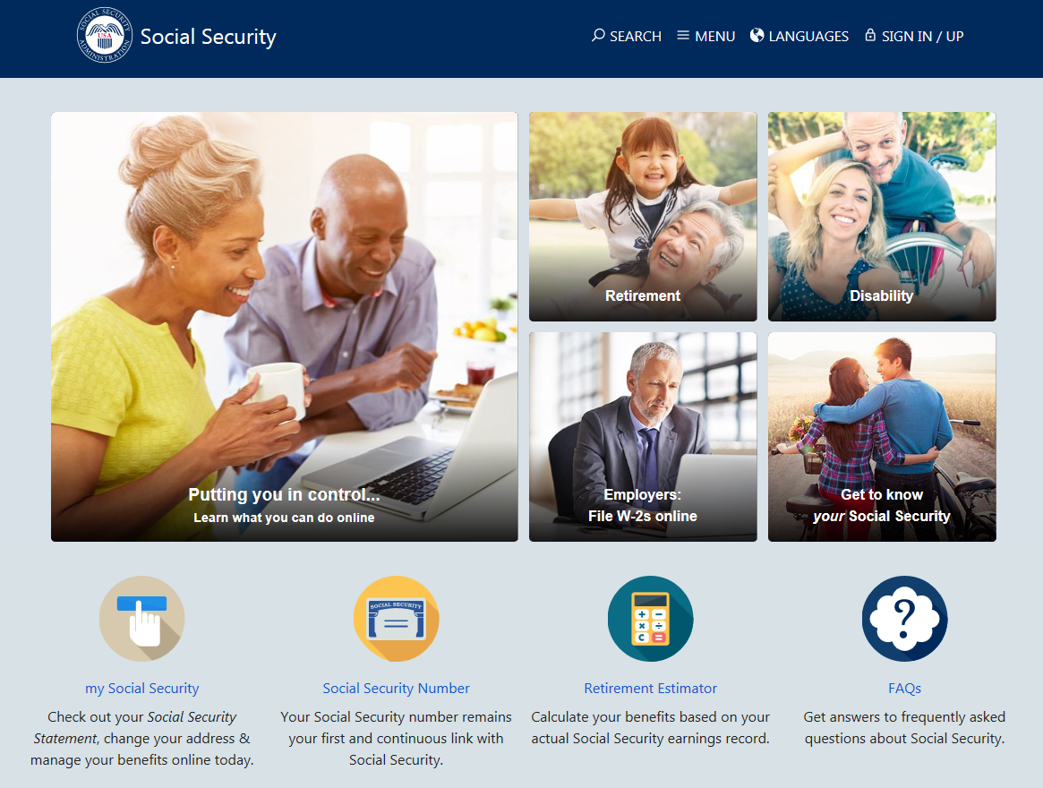
Social Security Website
Notes:
The Social Security website is a valuable resource of information about all of Social Security’s programs and is accessible from a computer, tablet and smartphone. We encourage you to use our online retirement planning tools to plan for a secure financial future.

Slide 28
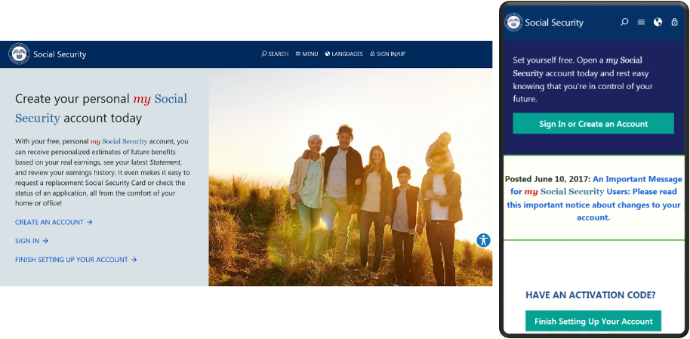
my Social Security
ssa.gov/myaccount
Notes:
my Social Security is a convenient and secure suite of services designed to put you in control of your personal Social Security information, as well as help you manage your benefits when you are ready. Your account gives you the information you need whenever you want. All without calling or visiting a field office.
You can only open a my Social Security account for yourself. You cannot open an account for another person, even if you have his or her written consent.
You may be unable to open a my Social Security account if you:
• Blocked electronic access to your personal Social Security information;
• Recently moved or changed your name; or
• Placed a freeze on your credit report.
Your online my Social Security account provides a variety of information to help you and your family. If you need help setting up your account, we have a 4-minute walkthrough video on our YouTube page.

Slide 29
my Social Security Services
If you receive benefits or have Medicare, you can:
  Opt out of mailed notices for those available online;
  Request a replacement Social Security card if you meet certain requirements;
  Report your wages if you work and receive Disability Insurance (SSDI) and/or Supplemental Security Income (SSI) benefits;
  Get a benefit verification letter as proof that you are getting benefits;
  Check your benefit and payment information and your earnings record;
  Change your address and phone number;
  Start or change direct deposit of your benefit payment;
  Submit your advance designation of representative payee request;
  Request a replacement Medicare card; and
  Get a replacement SSA-1099 or SSA-1042S for tax season.
  ssa.gov/myaccount/what.html
Notes:
So what can you do with a my Social Security account? Your online my Social Security account provides a wealth of information to help you and your family plan for your financial future
URL updated 12/17/2020 (JP)

Slide 30
my Social Security Services
If you do not receive benefits, you can:
  View retirement benefit estimates at different ages or dates when you want to start receiving benefits;
  View possible spouse’s benefits;
  Request a replacement Social Security card if you meet certain requirements;
  Check the status of your application or appeal;
  Get a benefit verification letter as proof that you are not getting benefits;
  Get your Social Security Statement to review:
    Estimates of your future retirement, disability, and survivor benefits;
    Your earnings record, to verify the amounts that we posted are correct; and
    The estimated Social Security and Medicare taxes you’ve paid.
  ssa.gov/myaccount/what.html
Notes:
Slide updated 2/18/2021 (JP)

Slide 31
Social Security Statement
New redesigned Statement
  Plain language, design, and graphics make it easier to find information.
  For example, we now provide a graph with retirement benefit estimates for up to 9 ages, depending on when you want benefits to start.
The Statement is one of Social Security’s most far-reaching educational tools.
  In 2020, we provided more than 83 million Statements in print and online.
Workers age 18 and older can access their Statement online using my Social Security.
  We mail a Statement to workers age 60 and older who do not have an online account.
  Anyone can send in a written request to have a Statement mailed to them.
  ssa.gov/myaccount/statement.html
Notes:
10/6/2021 – slide updated (JP)

Slide 32
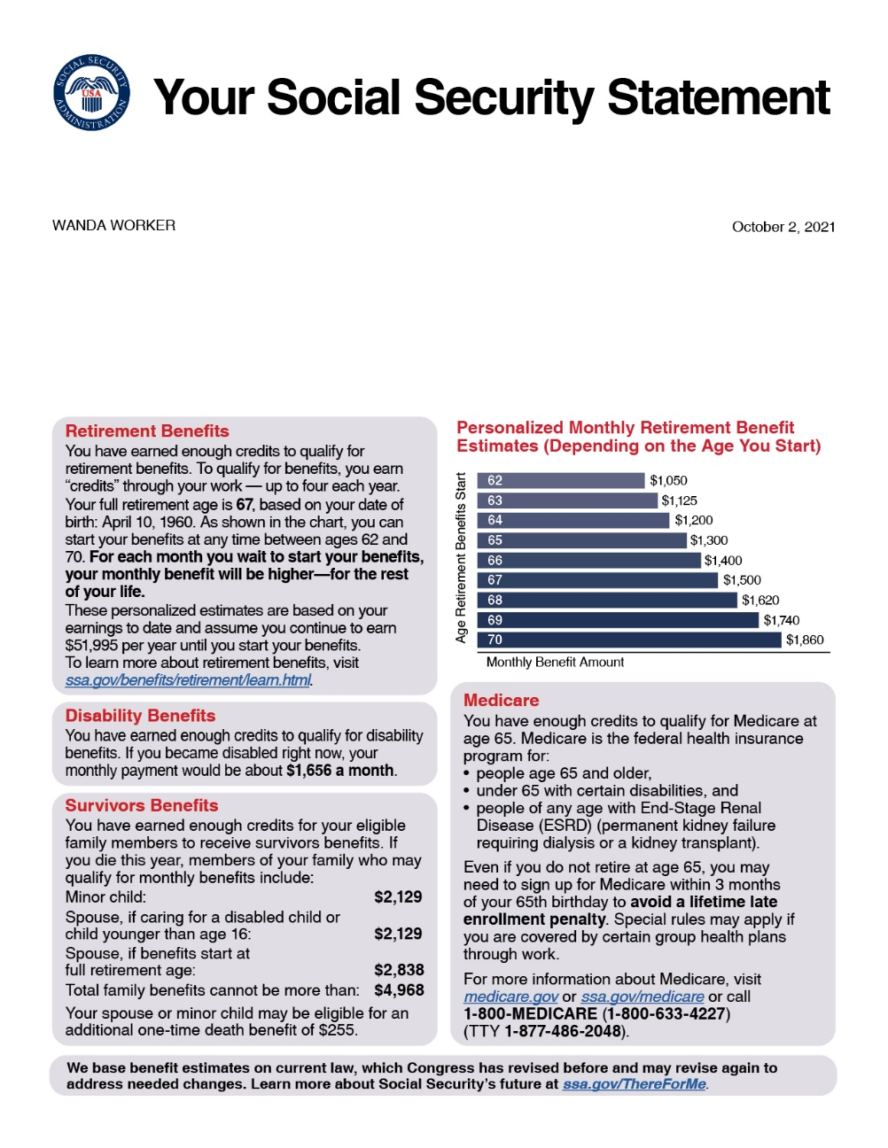
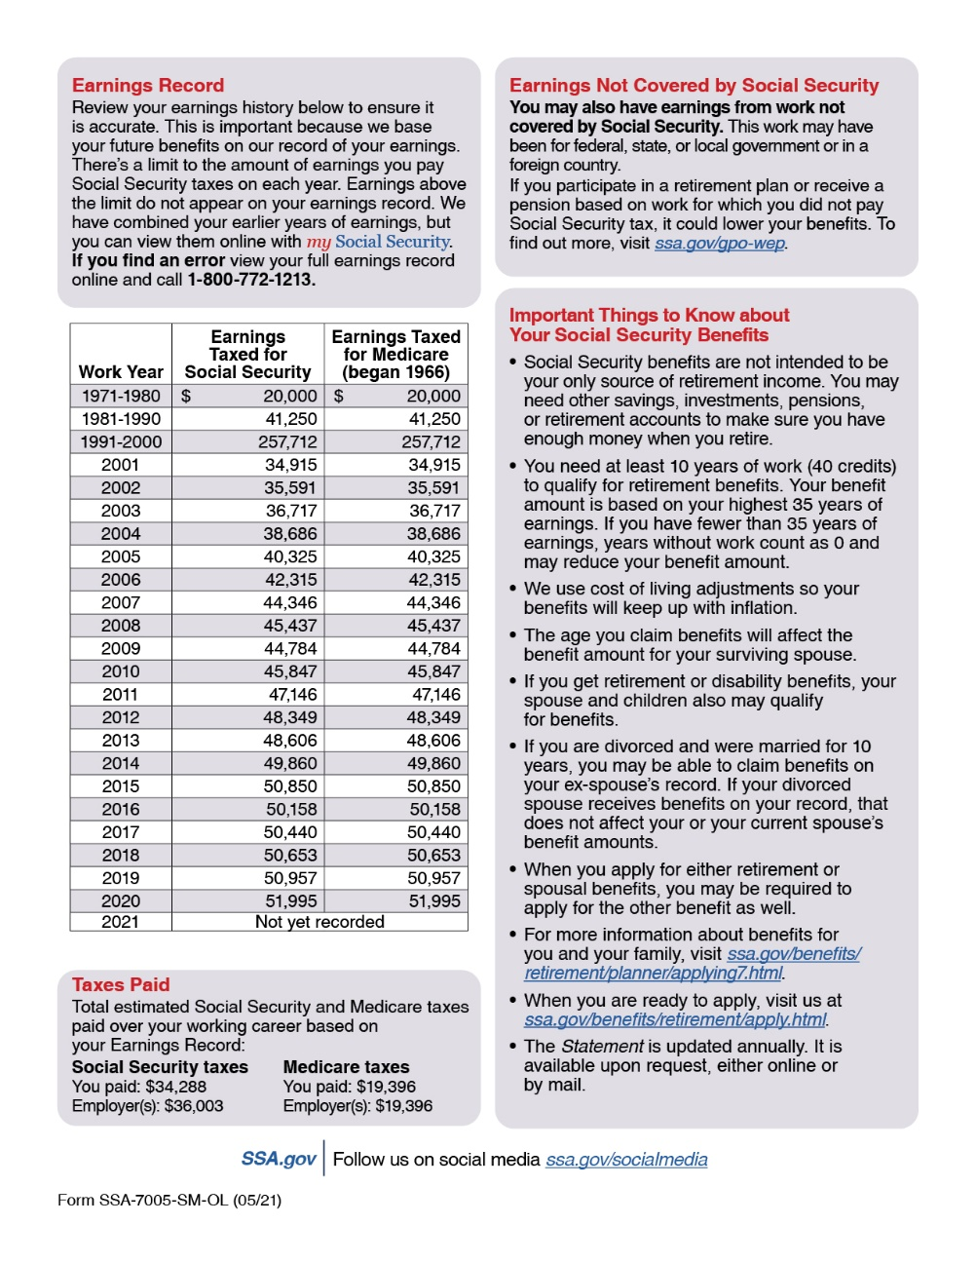
Social Securiaaty Statement
Notes:
10/6/2021 – slide updated (JP)

Slide 33
Enhanced Security for your my Social Security Account
We recently added a second method to check the identification of account holders when you register or sign in.
This is in addition to the first layer of security, your username and password.
You will be able to choose either your cell phone or your email address as your second identification method.
Notes:
Social Security continues to evaluate and improve how we protect what’s important to you. We take this responsibility seriously, and we have a robust cybersecurity program in place to help protect the personal information you entrust to us. Adding additional security measures to safeguard your personal information — but making our services easy to use — is a vital part of keeping you safe and secure.
On June 10, 2017, we added a second method to check your identification when you sign in to my Social Security.
This is in addition to the first layer of security, your username and password.
The next time you sign in, you will be able to choose either your cell phone or your email address as your second identification method.
Using two ways to identify you when you log on will help better protect your account from unauthorized use and potential identity fraud.
We’re committed to using the best technologies and standards available to protect our customers’ data. This new security advancement is just one of the ways we’re ensuring the safety of the resources entrusted to us.
In addition to these security enhancements, we are also upgrading the look and feel of my Social Security, in an effort to create an enhanced customer experience. The my Social Security portal will automatically adjust to the size of the screen and kind of device you are using – such as a tablet, smart phone, or computer. No matter what type of device you choose, you will have full, easy-to-use access to your personal my Social Security account.

Slide 34
my Social Security
You can assist someone in creating a my Social Security account if they:
are with you;
have their own email address;
can answer the “out of wallet” questions; and
have been appointed a payee.
You cannot create a my Social Security account on behalf of another person by using another person's information or identity, even if you have that person's written permission.
For example, you cannot create an account for another person:
with whom you have a business relationship;
for whom you are a representative payee; or
for whom you are an appointed representative.

Slide 35





Follow Us on Social Media!
@SocialSecurity

Slide 36

We’re With You Through Life’s Journey
Notes:
Social Security offers much more than just retirement. We provide a safety net of financial protection for your whole family.
We’re with you throughout life’s journey– With retirement, disability, survivors, and other benefits, Social Security is here to help you and millions of others secure today and tomorrow.

Slide 37

Q&A Session
Notes:
Option for speaker:
You can use this slide OR switch to the visual “Rotating Brand Images” presentation found on the PARC as a scrolling visual while answering questions.
Rotating Brand Images PowerPoint: https://eis.ba.ssa.gov/crc/parc/marketing/audiences/general/UniversalPowerPoint.html

